Slide 1
Building a prescribed fire database for the western United States
Kori Blankenship & Teresa Chapman

Slide 2
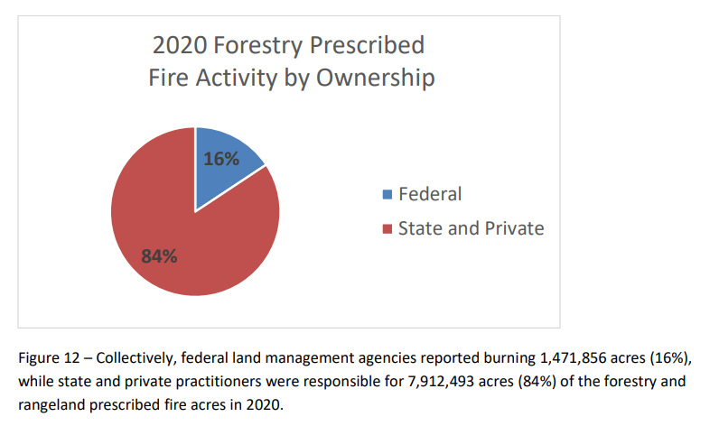
Background
National prescribed fire use report
Figure: 2021 National Prescribed Fire Use Survey Report, Coalition of Prescribed Fire Councils and the National Association of State Foresters
Notes:
Problem:
Interested in fuel tx effectiveness
No reporting system for all burns
Difficult to detect rx fire remotely, private burns generally not collect in public repository
2021-National-Rx-Fire-Use-Report_FINAL.pdf (prescribedfire.net)
Prepared by the Coalition of Prescribed Fire Councils and the National Association of State Foresters based on a survey of prescribed fire use data collected in 2020

Slide 3
Data
 | Burn Type¹ | Complete² | Polygon³ | Years of Collection
 |  |  |  | pre-2010 | 2010 | 2011 | 2012 | 2013 | 2014 | 2015 | 2016 | 2017 | 2018 | 2019 | 2020 | 2021 | 2022
AZ |  | X
CA | X | X | X
CO | X | X | X
ID | X
MT | X | X
ND
NM | X | X
NV | X | X
OR | X | X
SD
UT | X | X
WA | X |  | X
WY | X | X
¹Burn type indicates whether the permit distinguishes broadcast, pile, and other types of burning.
²Complete indicates state where burn completion is tracked. If it is not tracked, we only know what was permitted.
³Polygon indicates states with additional state-level polygon data about prescribed burns.
Notes:
Public records requests for state permits
State permit data are, to our knowledge, an untapped resource for tracking prescribed burns. These data will be especially useful for tracking burning on private lands, which are largely left out of other data collection efforts.
~275k points
ND IS WRONG HERE
Make a horizontal bar plot w/ # of records and give the n as shown in screen cap above
Map: burn type reported, ag burns, Indian lands burns, permitted, complete, request

Slide 4
Methods
Cleaning
Standardizing
Unique burns: state, year, lat/lon, burn type, tracking number, burn name
DATABASE
Date
Latitude
Longitude
Acres permitted
Acres completed
Pile volume
Burn name
Burn type
Entity requesting
Notes:
1. cleaning: removed ag, barrel burning, fixed lat/lons
2. Standardizing – classified as burn/pile, limited to overlapping years

Slide 5
Results
Amazing map here
Notes:
56,610 burns

Slide 6
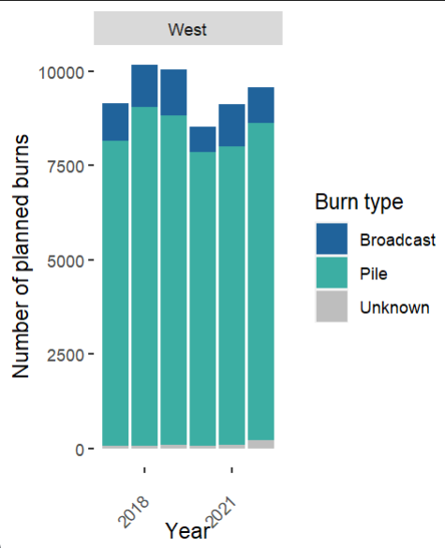
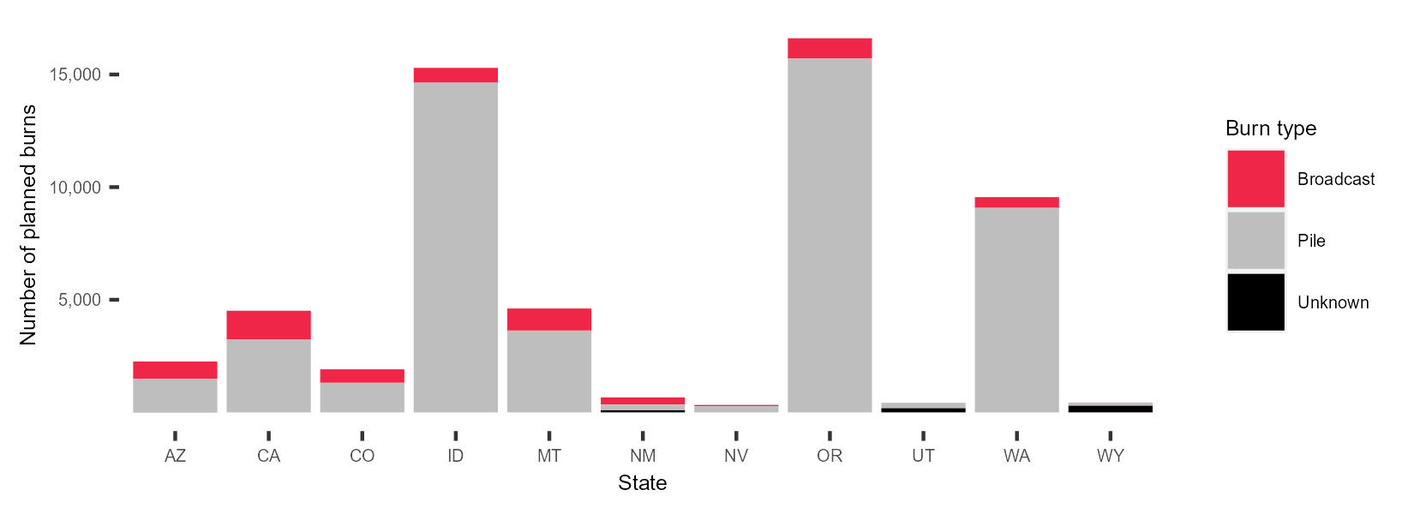
Results
Number of planned burns 2017-2022
Notes:
Add all west

Slide 7
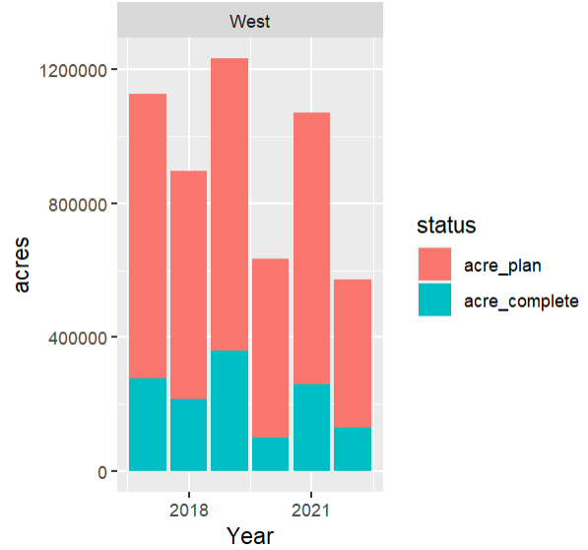
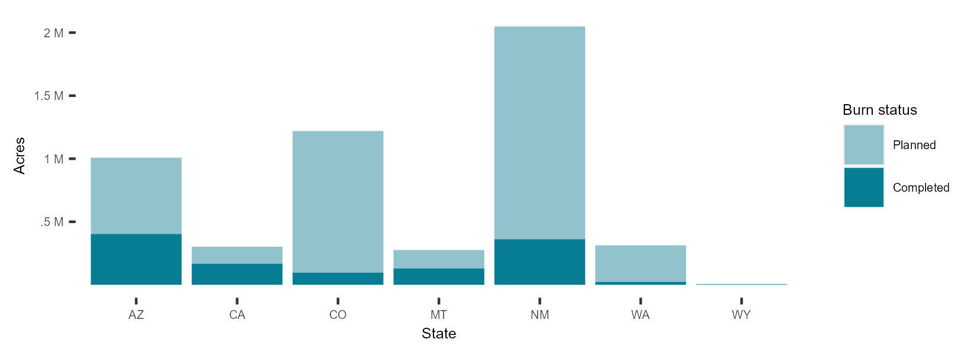
Results
Acres of broadcast burns 2017-2022
Notes:
OVERAL BY STATE, NOT YEAR
ACRES ON THE GRAPH (AT TOP OF EACH STATE GIVE A PERCENT); ADD AS TEXT THE % COMPLETE FOR EACH STATE
*estimated******
Map icon in bottom showing states included
Planned acres: permitted acres, max requested acres
* Change y lable to “Area burned (acres)

Slide 8
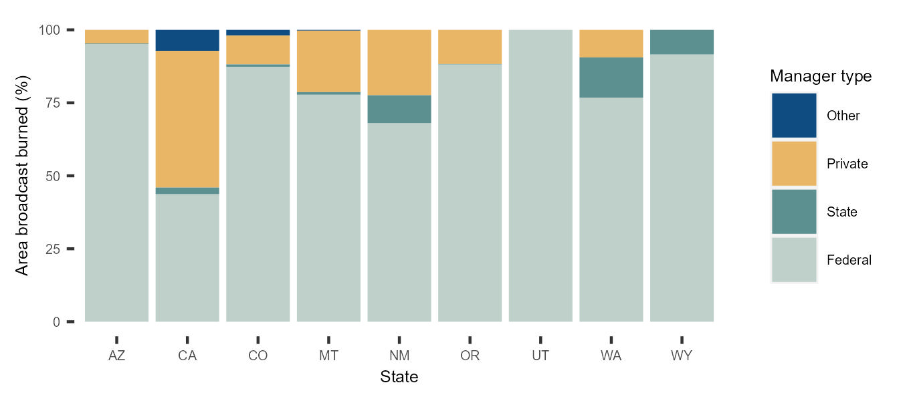
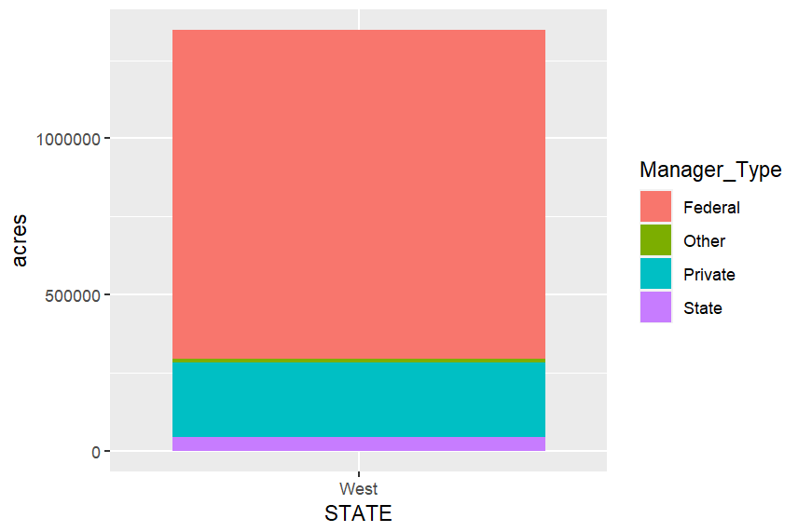
Results
Percent area broadcast burned by land manager 2017-2022
Notes:
Add West,
[put % in the legend or the box]

Slide 9
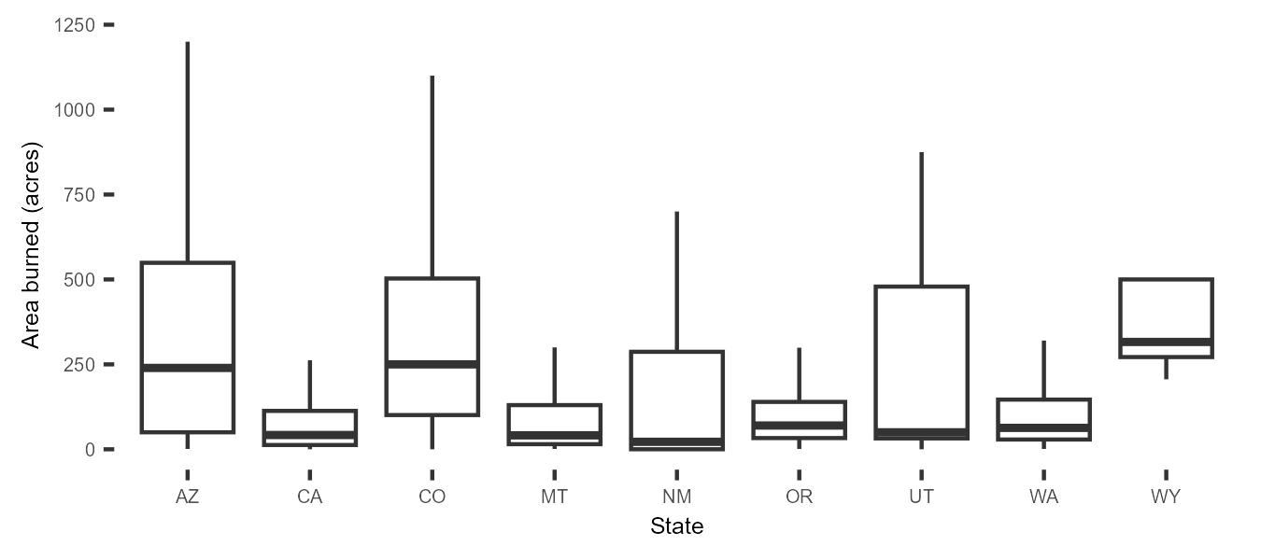
Results
Size of completed broadcast burns 2017-2022
Notes:
*** add the west

Slide 10
Summary
X times more pile than broadcast burned planned or completed .
X times more burns are planned than completed.
Broadcast burning on private lands accounts for x% of acres.
Median completed broadcast burn size is ~ XXX acres.
Understanding of prescribed burning is limited due to patchwork of recording systems.

Slide 11
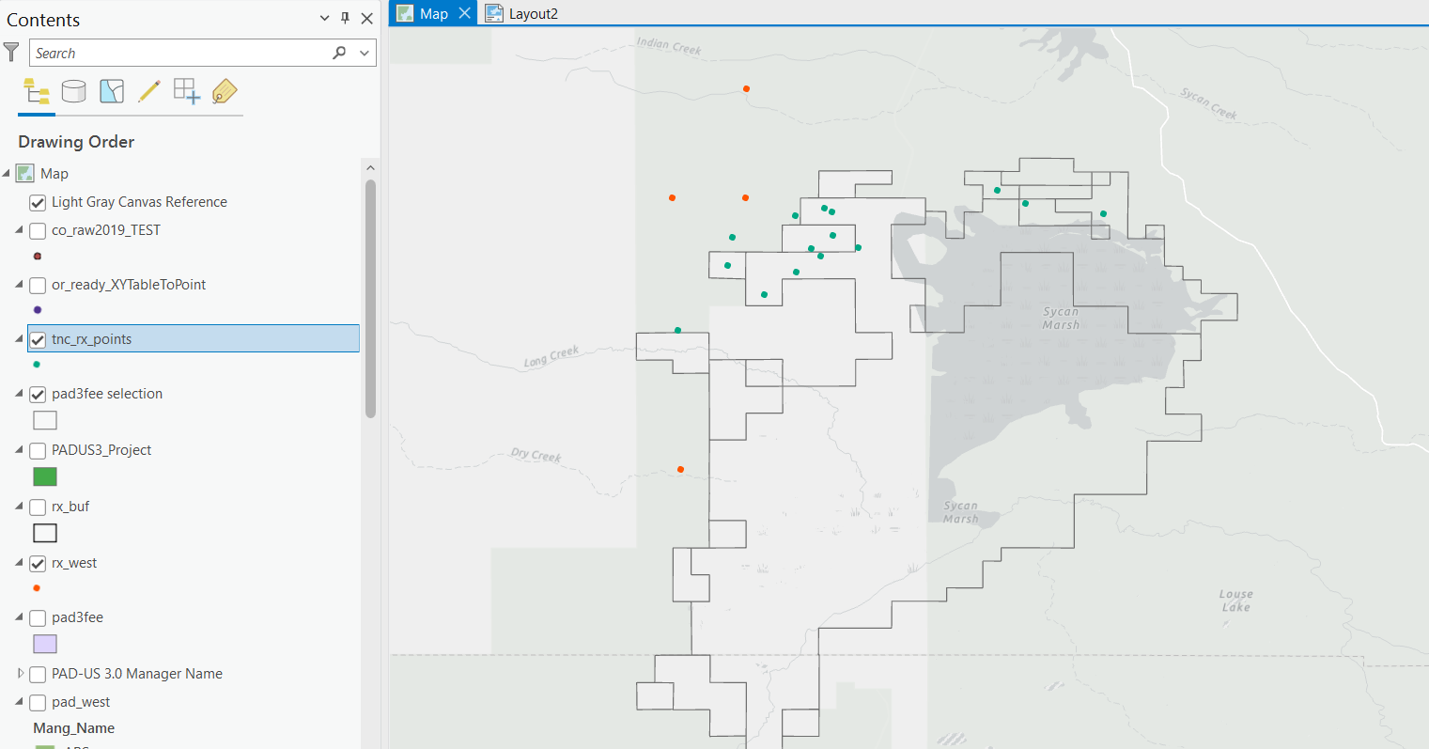
Next steps
Sycan Marsh Preserve completed burns
Notes:
Work on making the data more complete, add TNC points?
Validation: imagery, other data sources (NFPORS, FACTS)

Slide 12
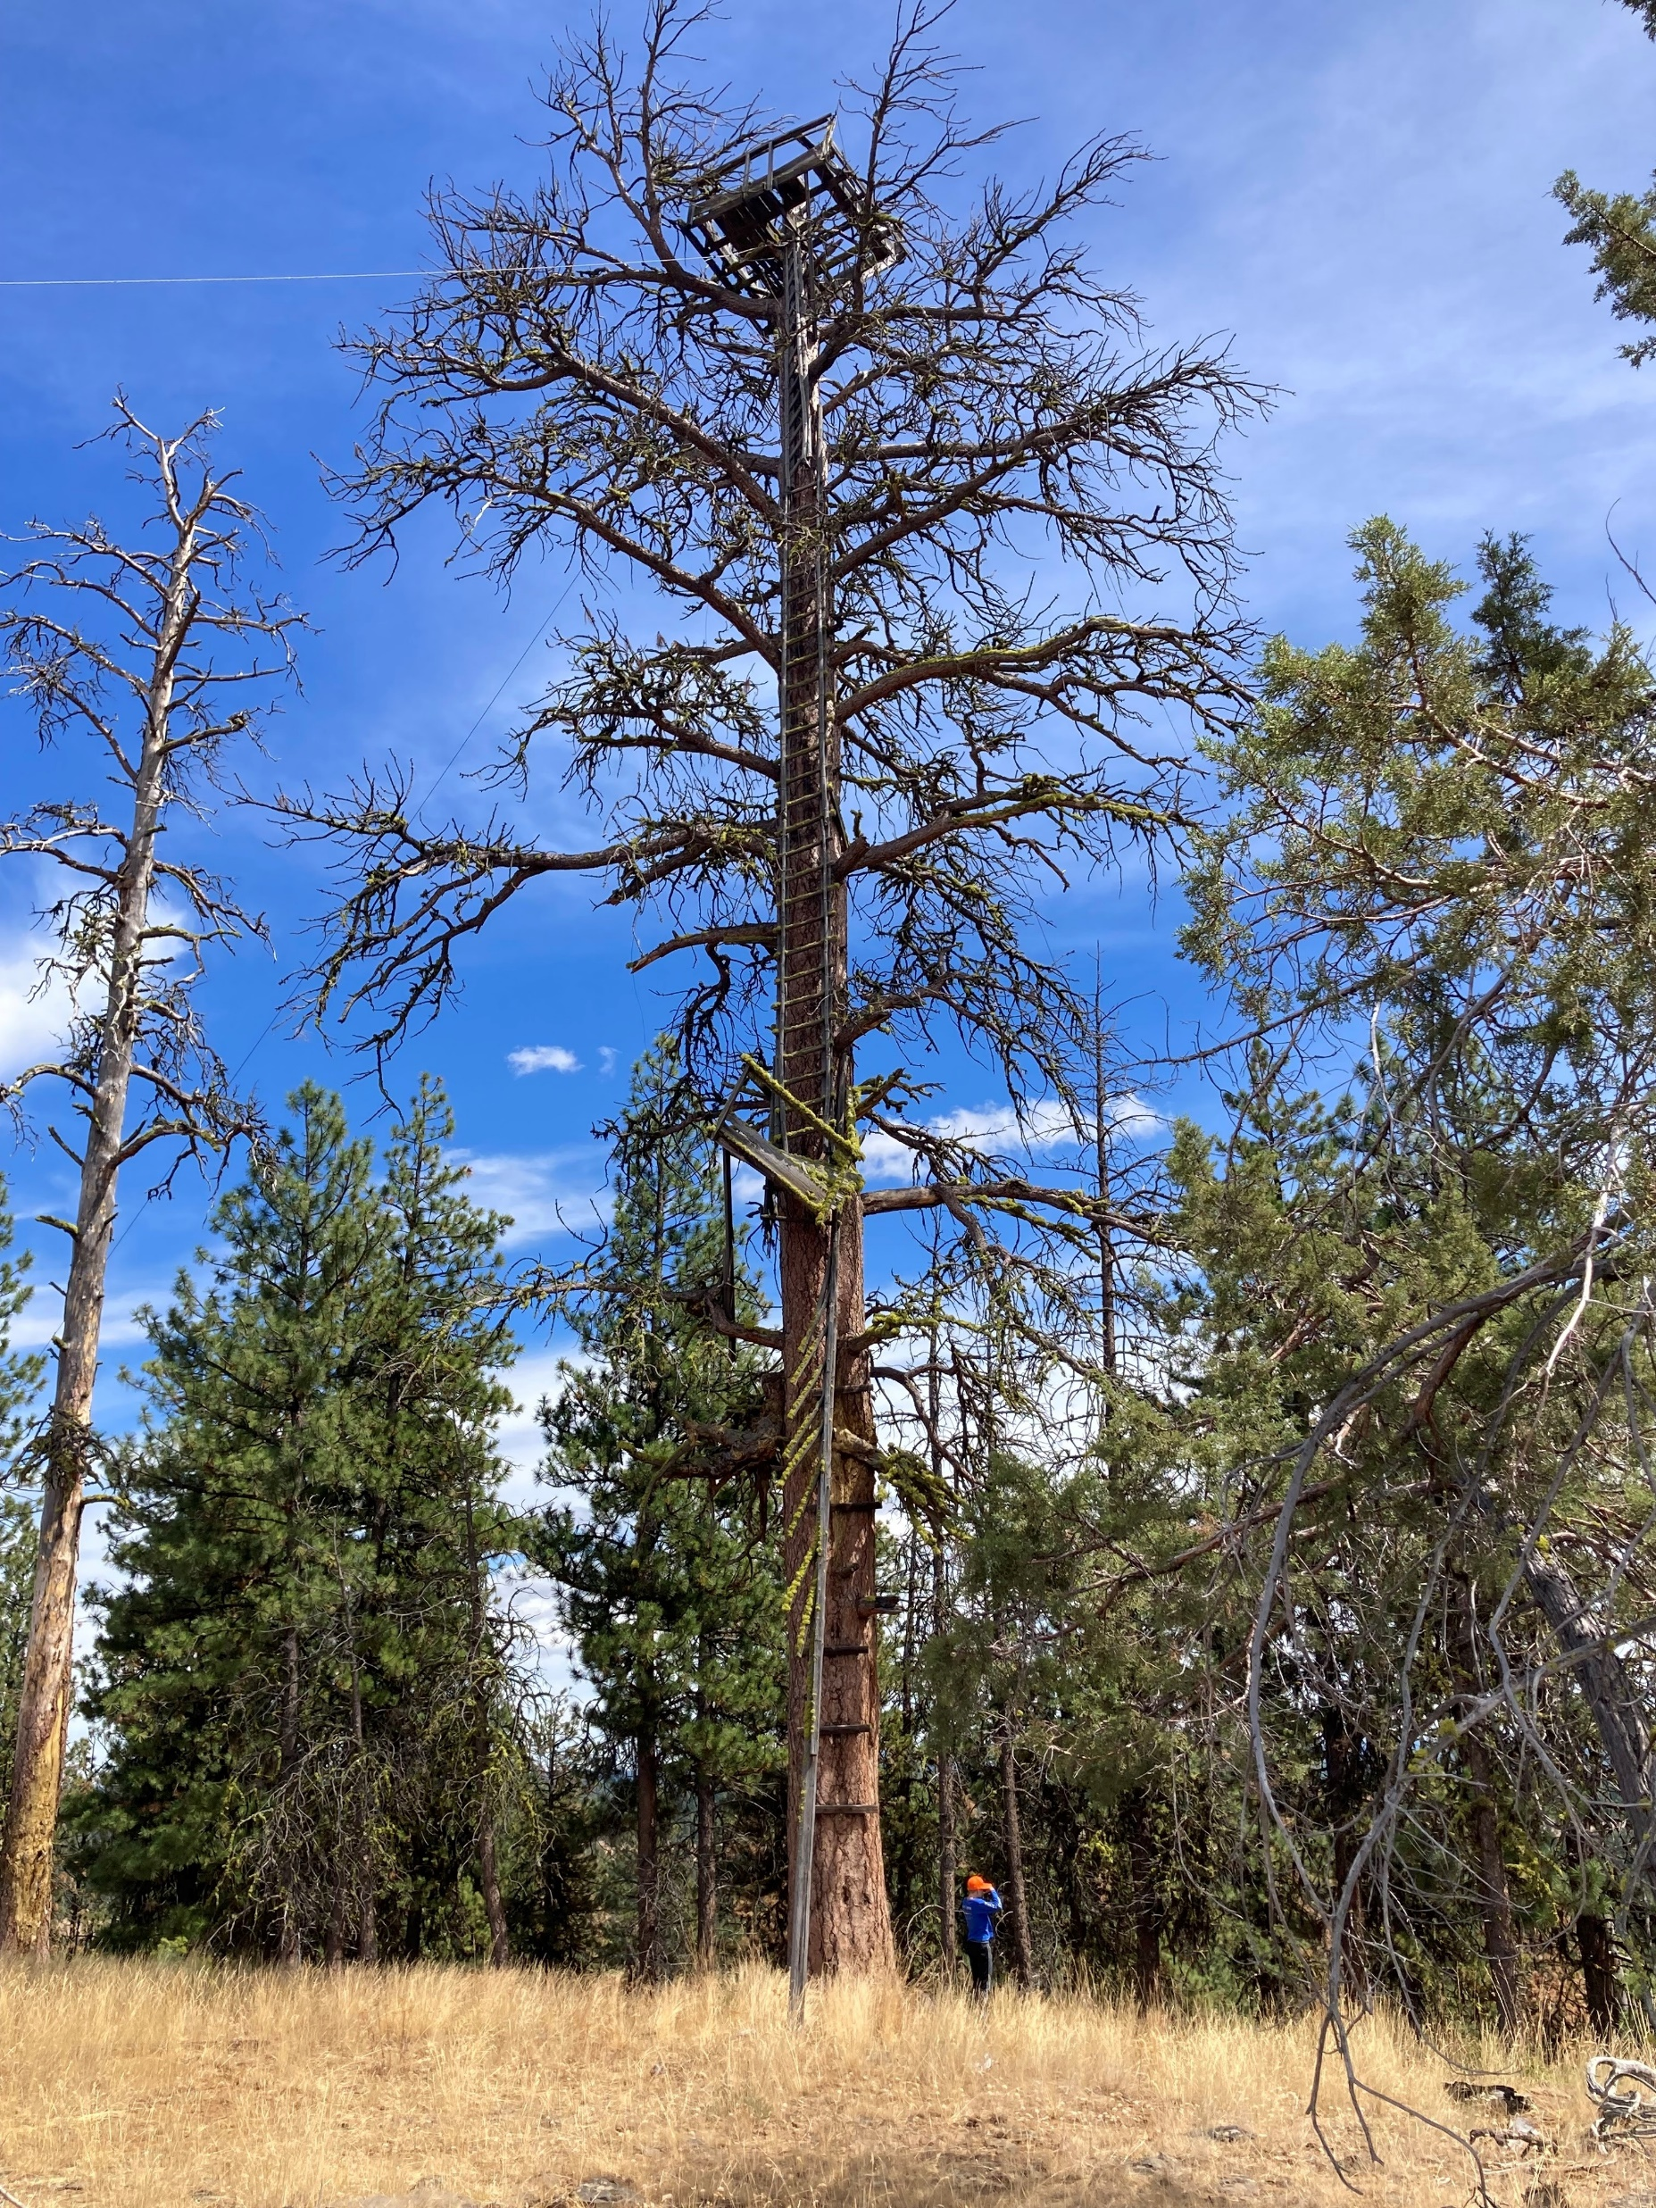
kblankenship@tnc.org
tchapman@tnc.org
Black Mountain lookout tree, OR.

Slide 13
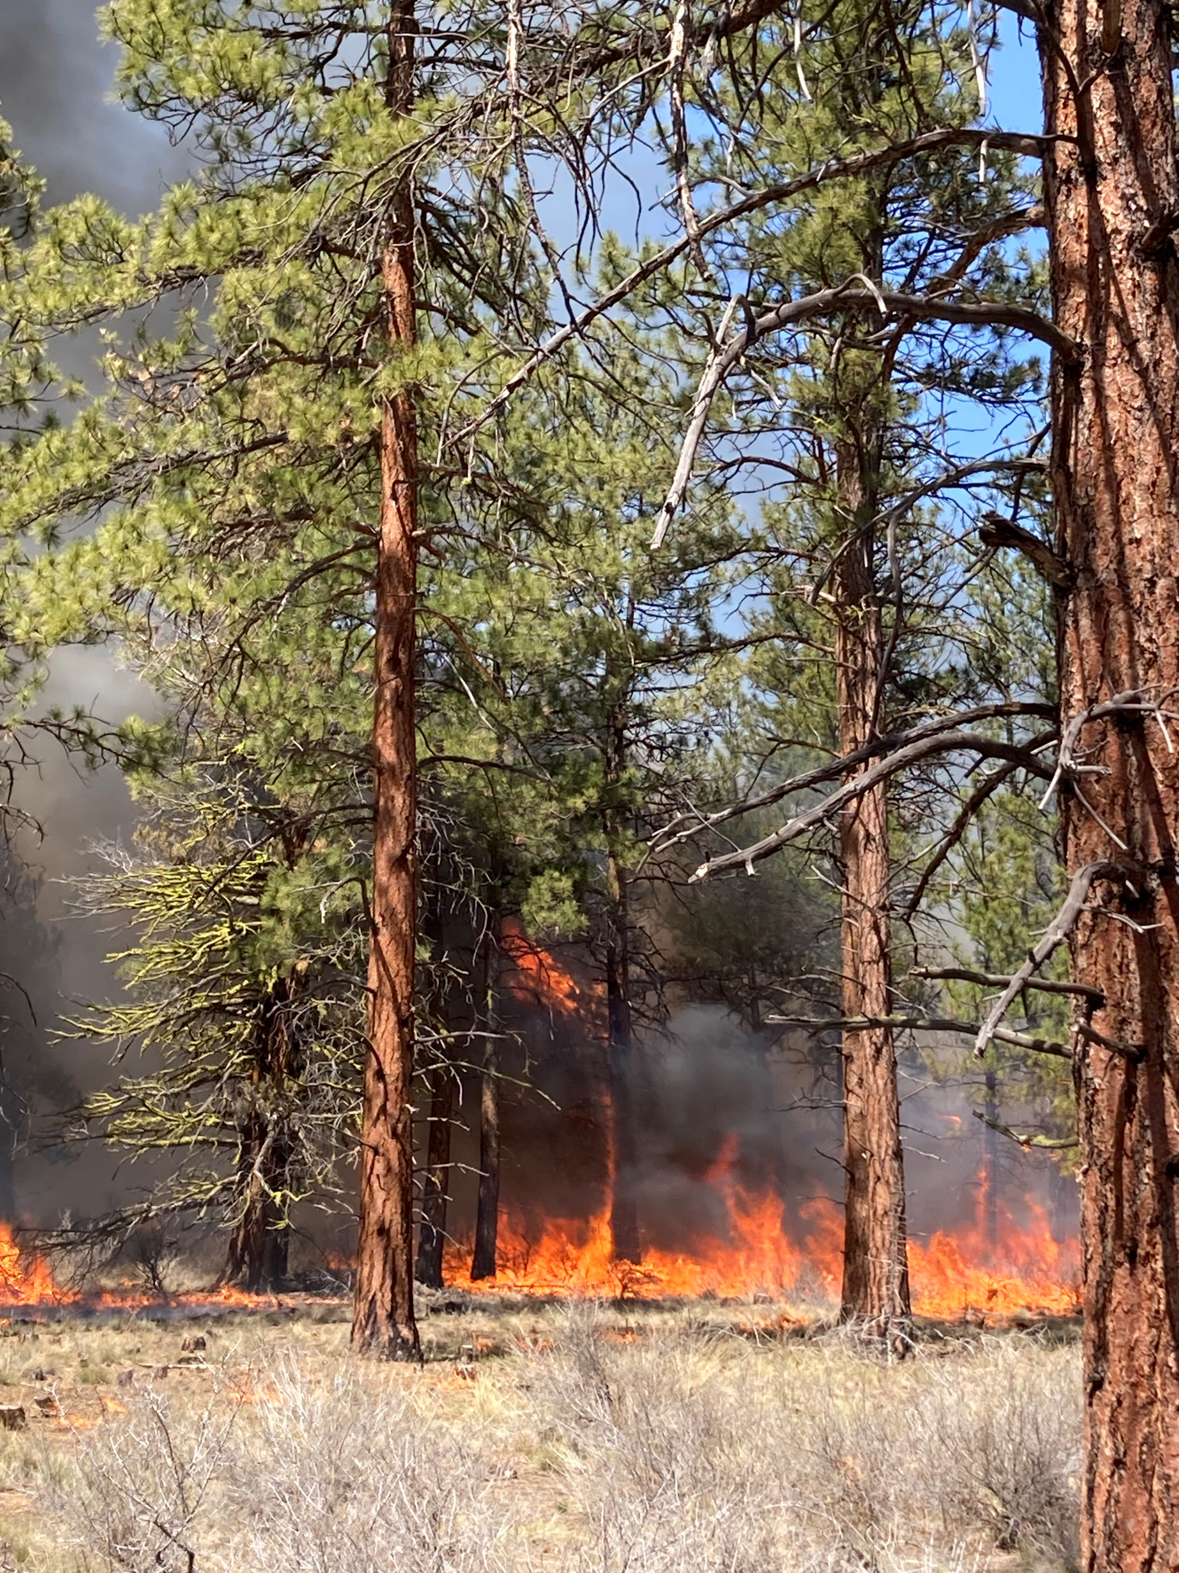
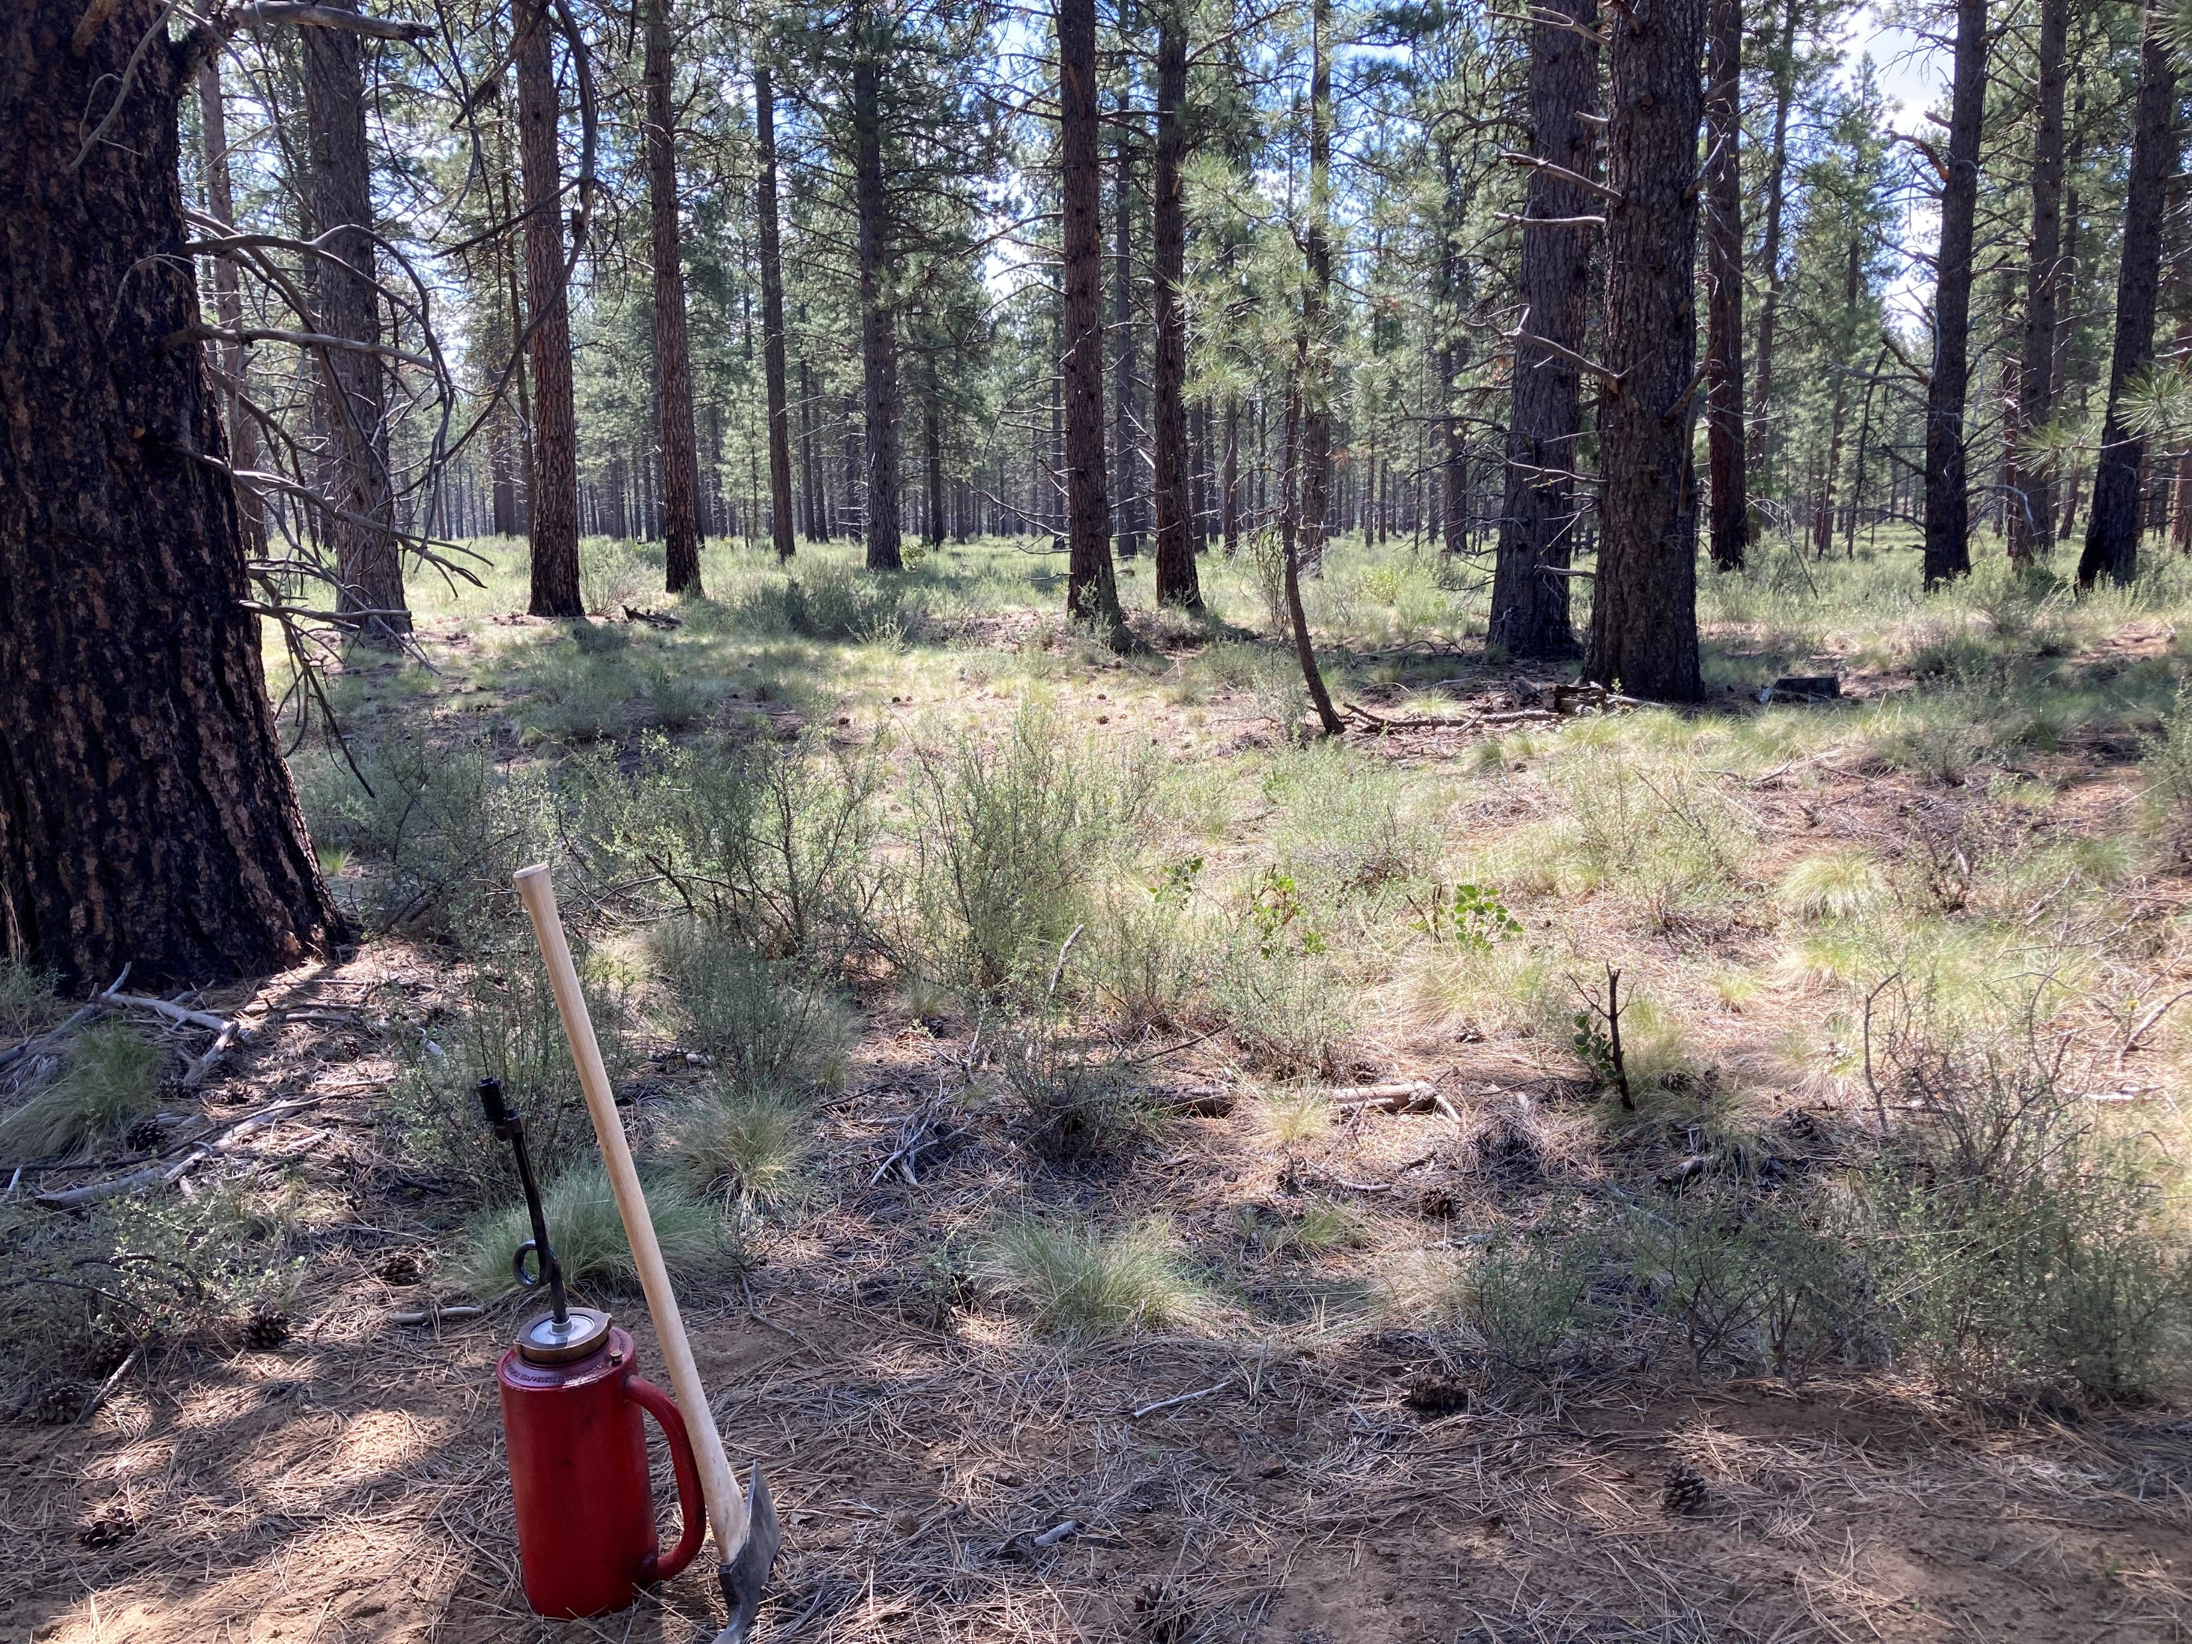
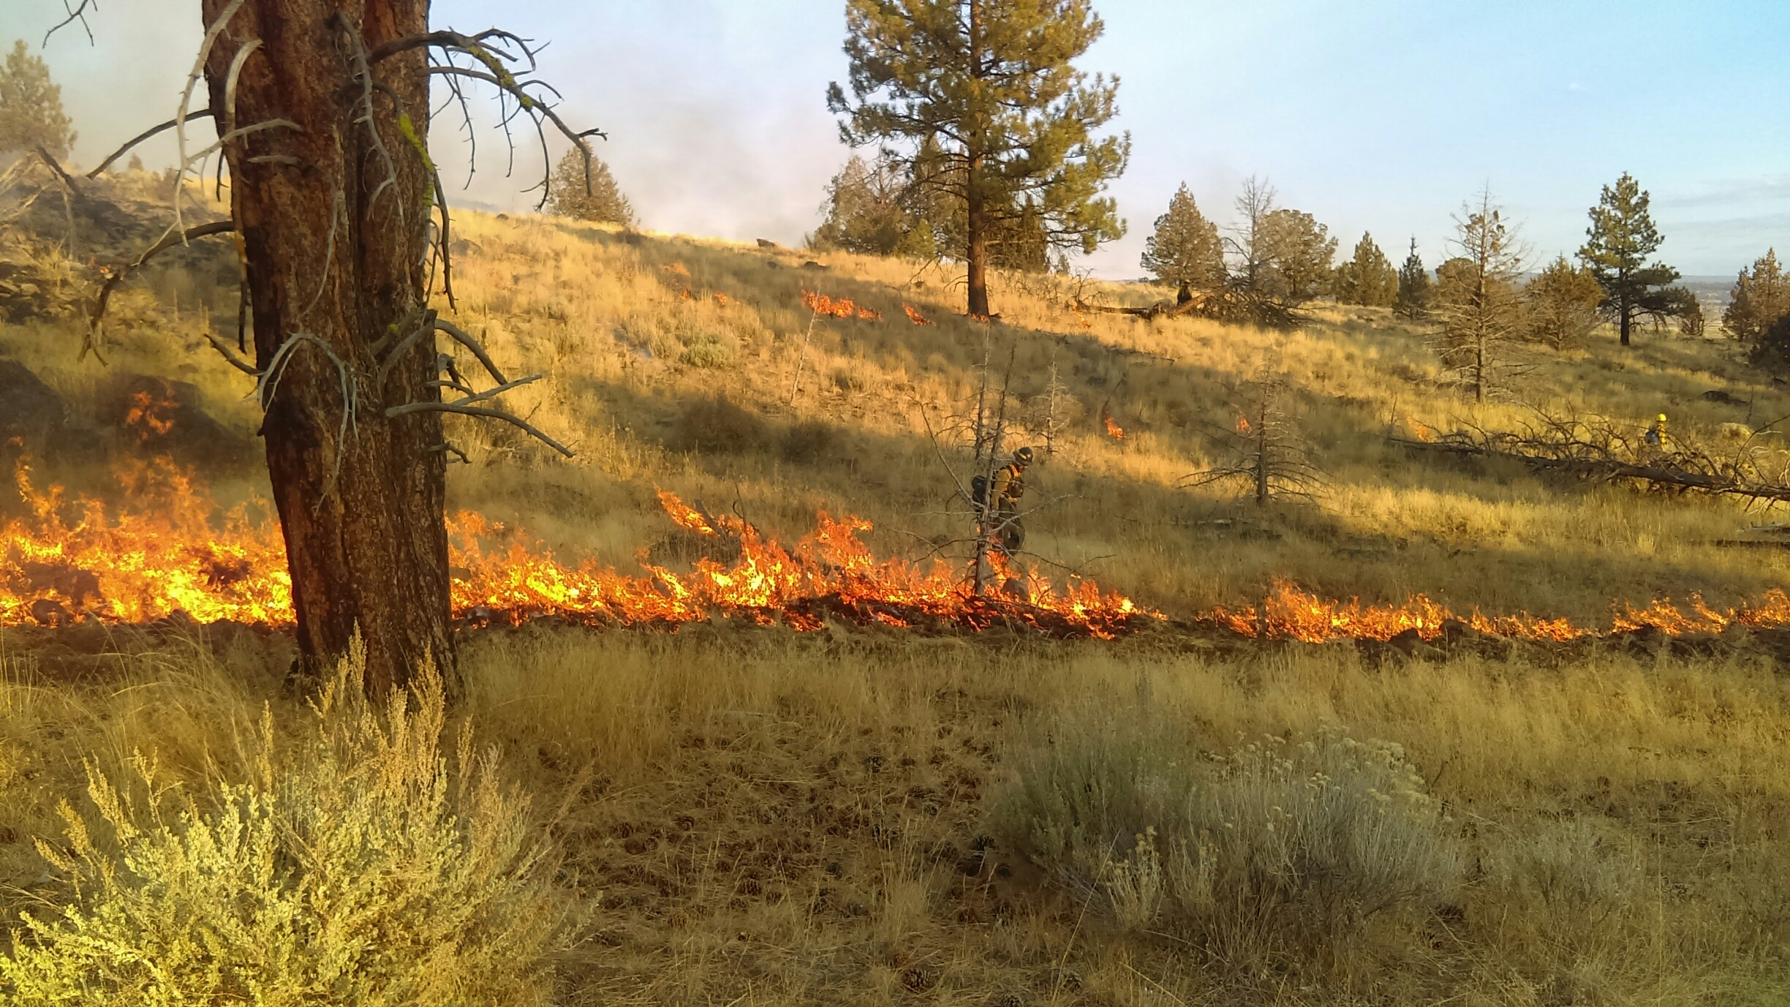
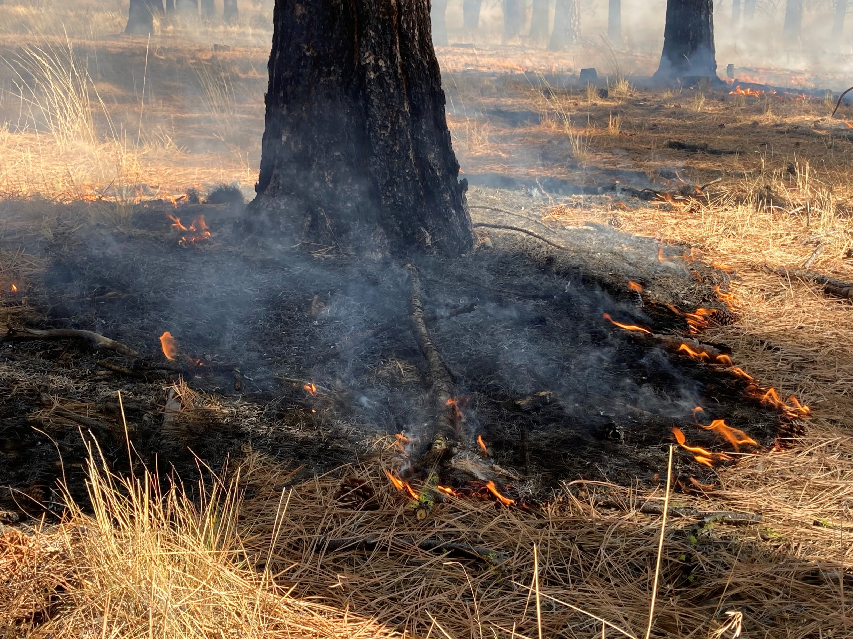

Slide 14
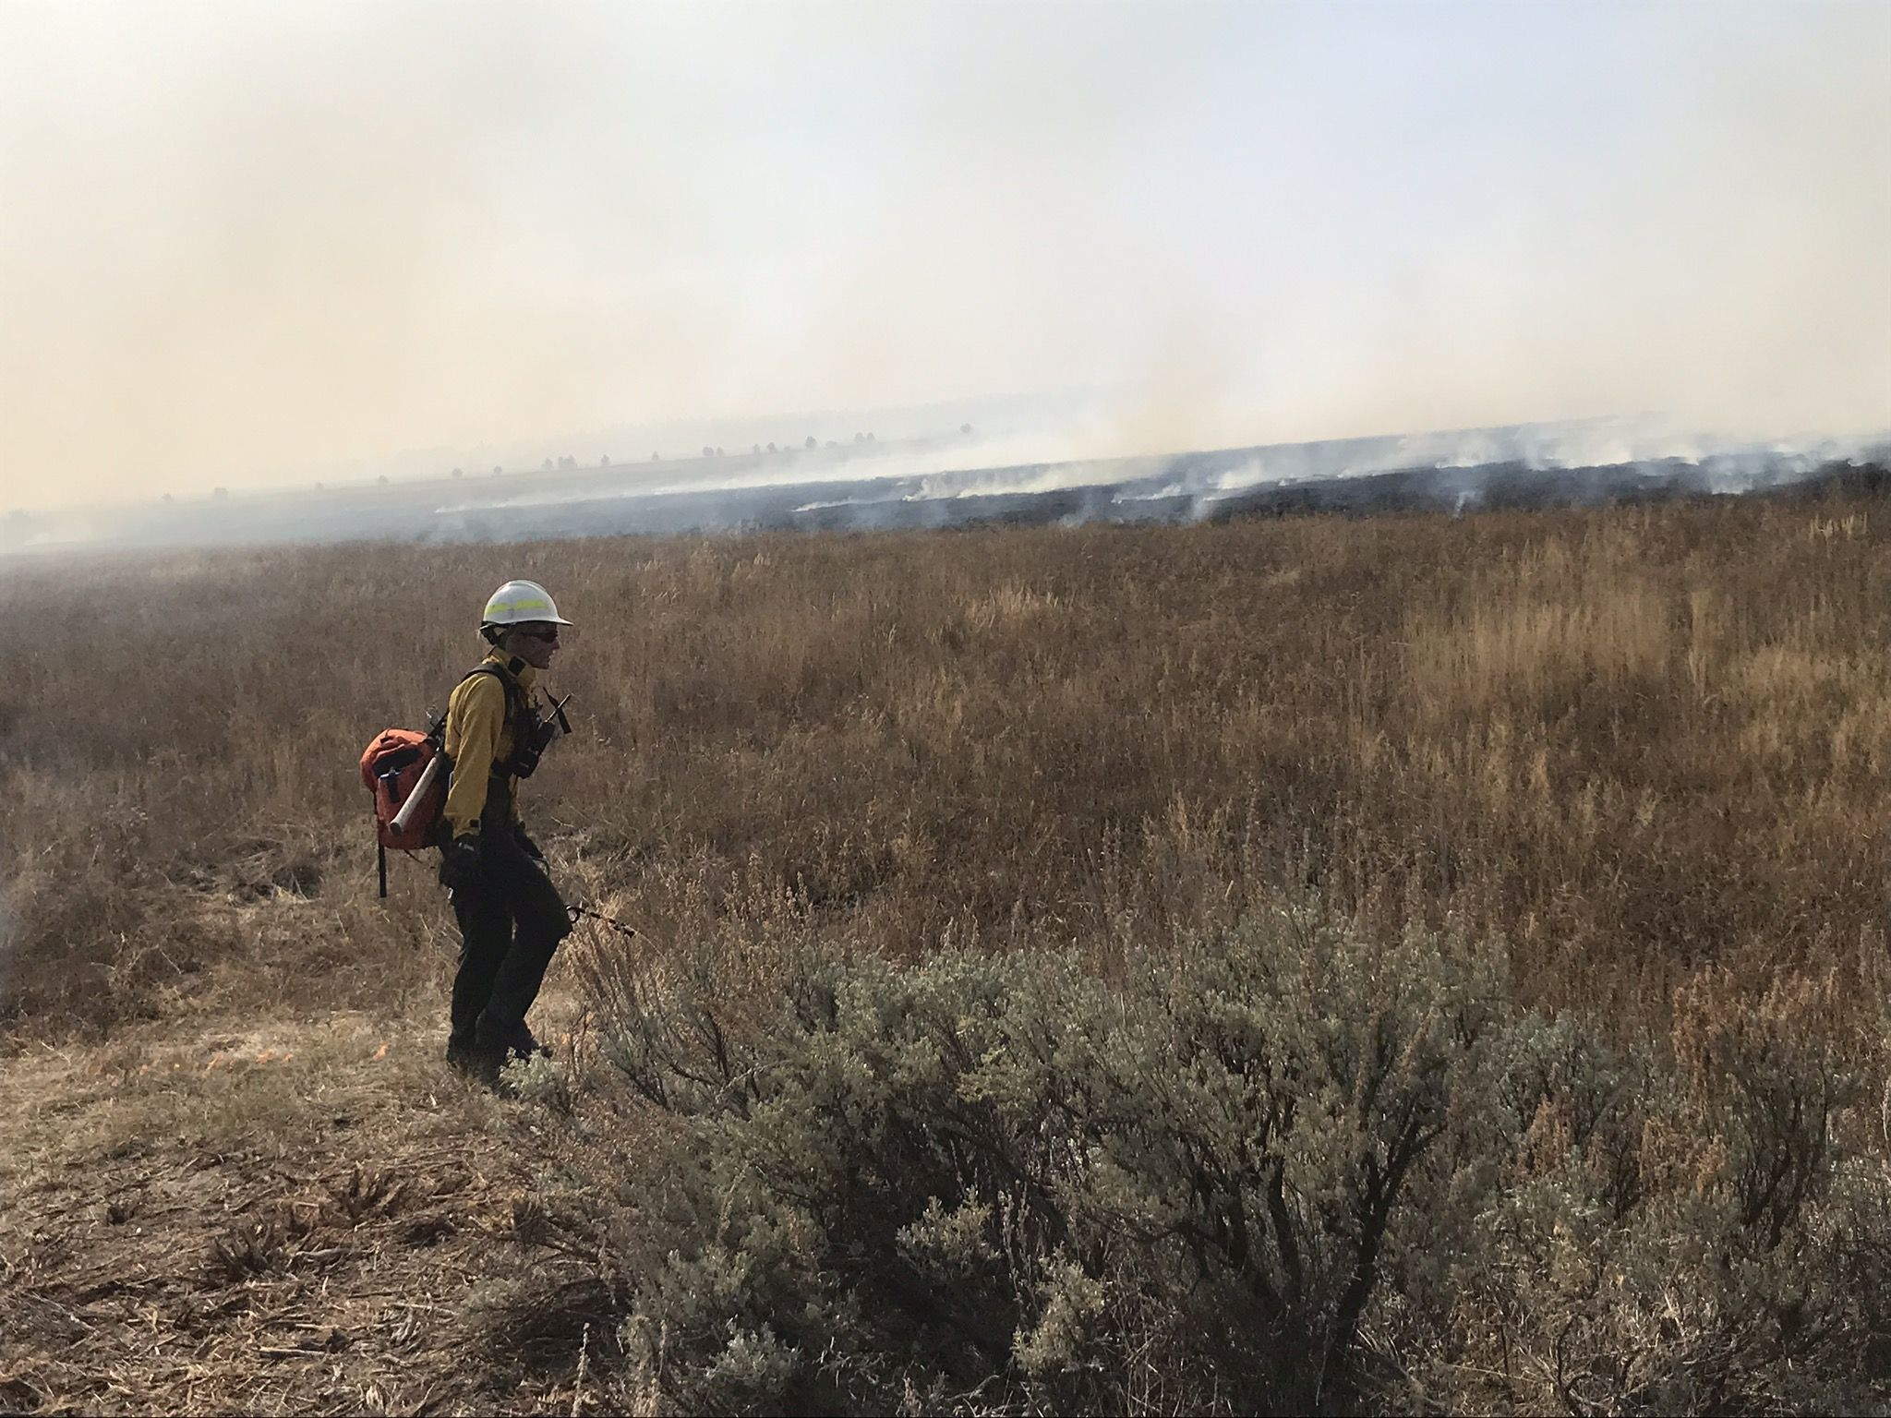
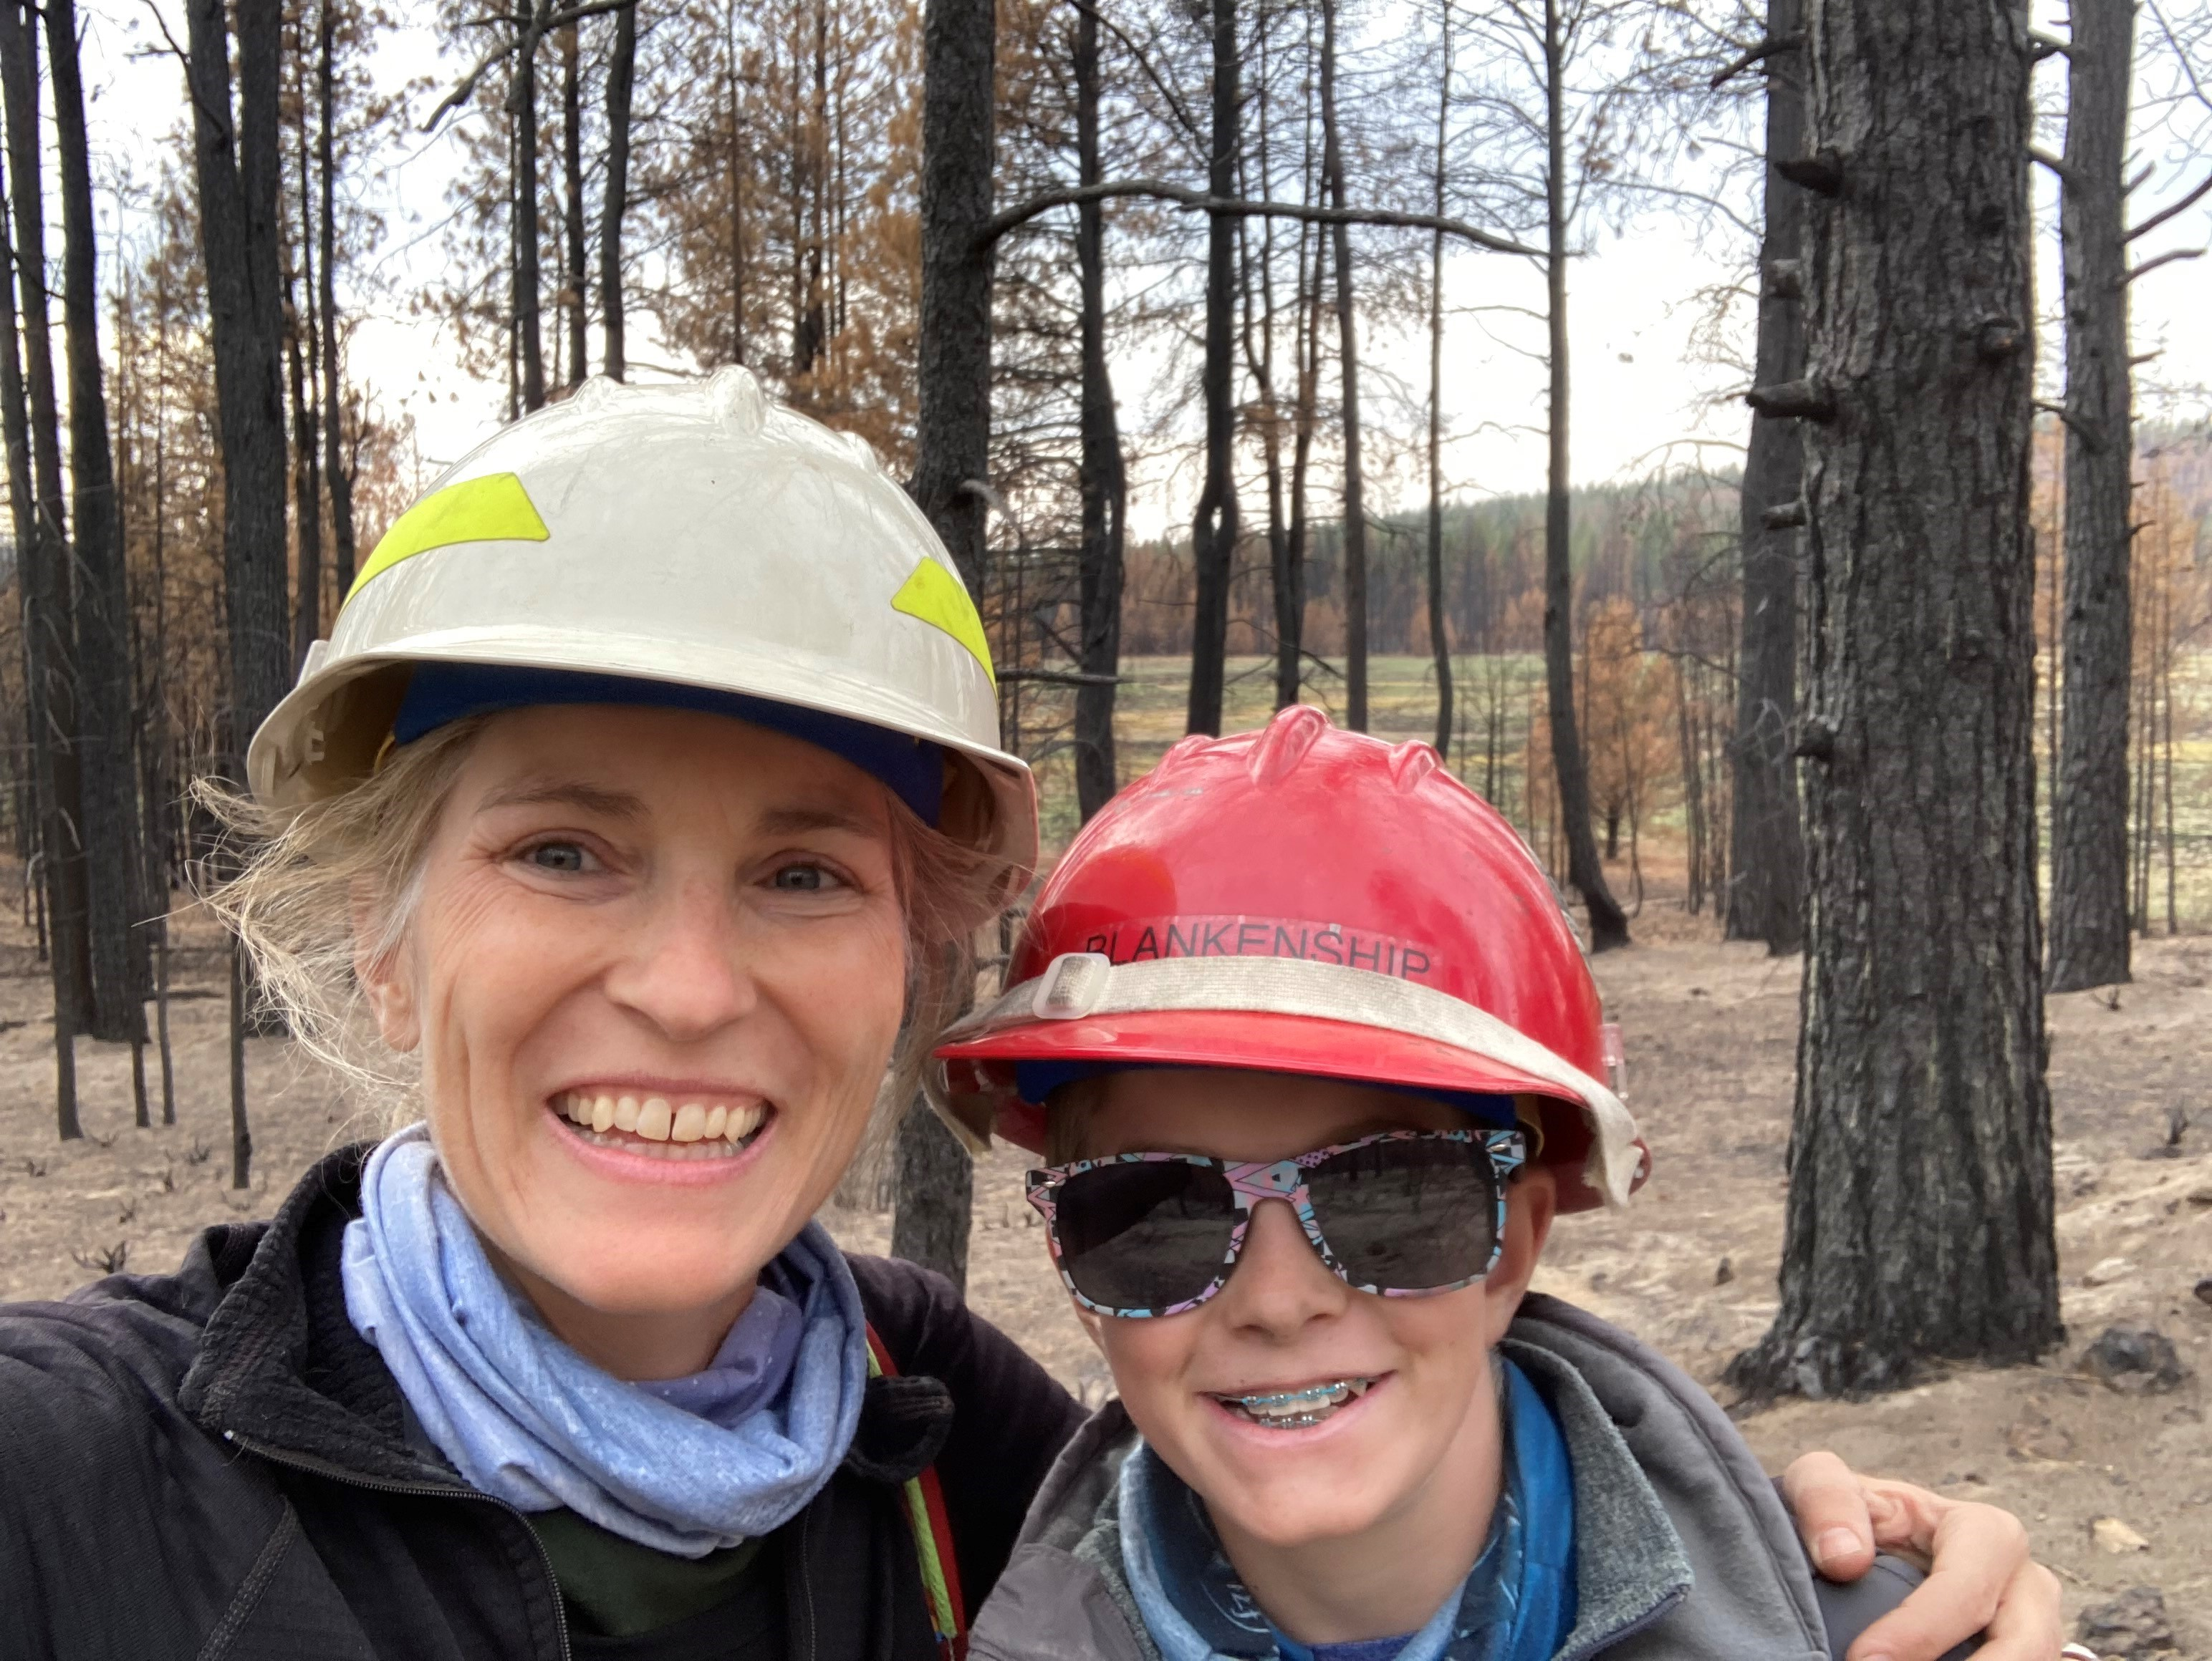

Slide 15
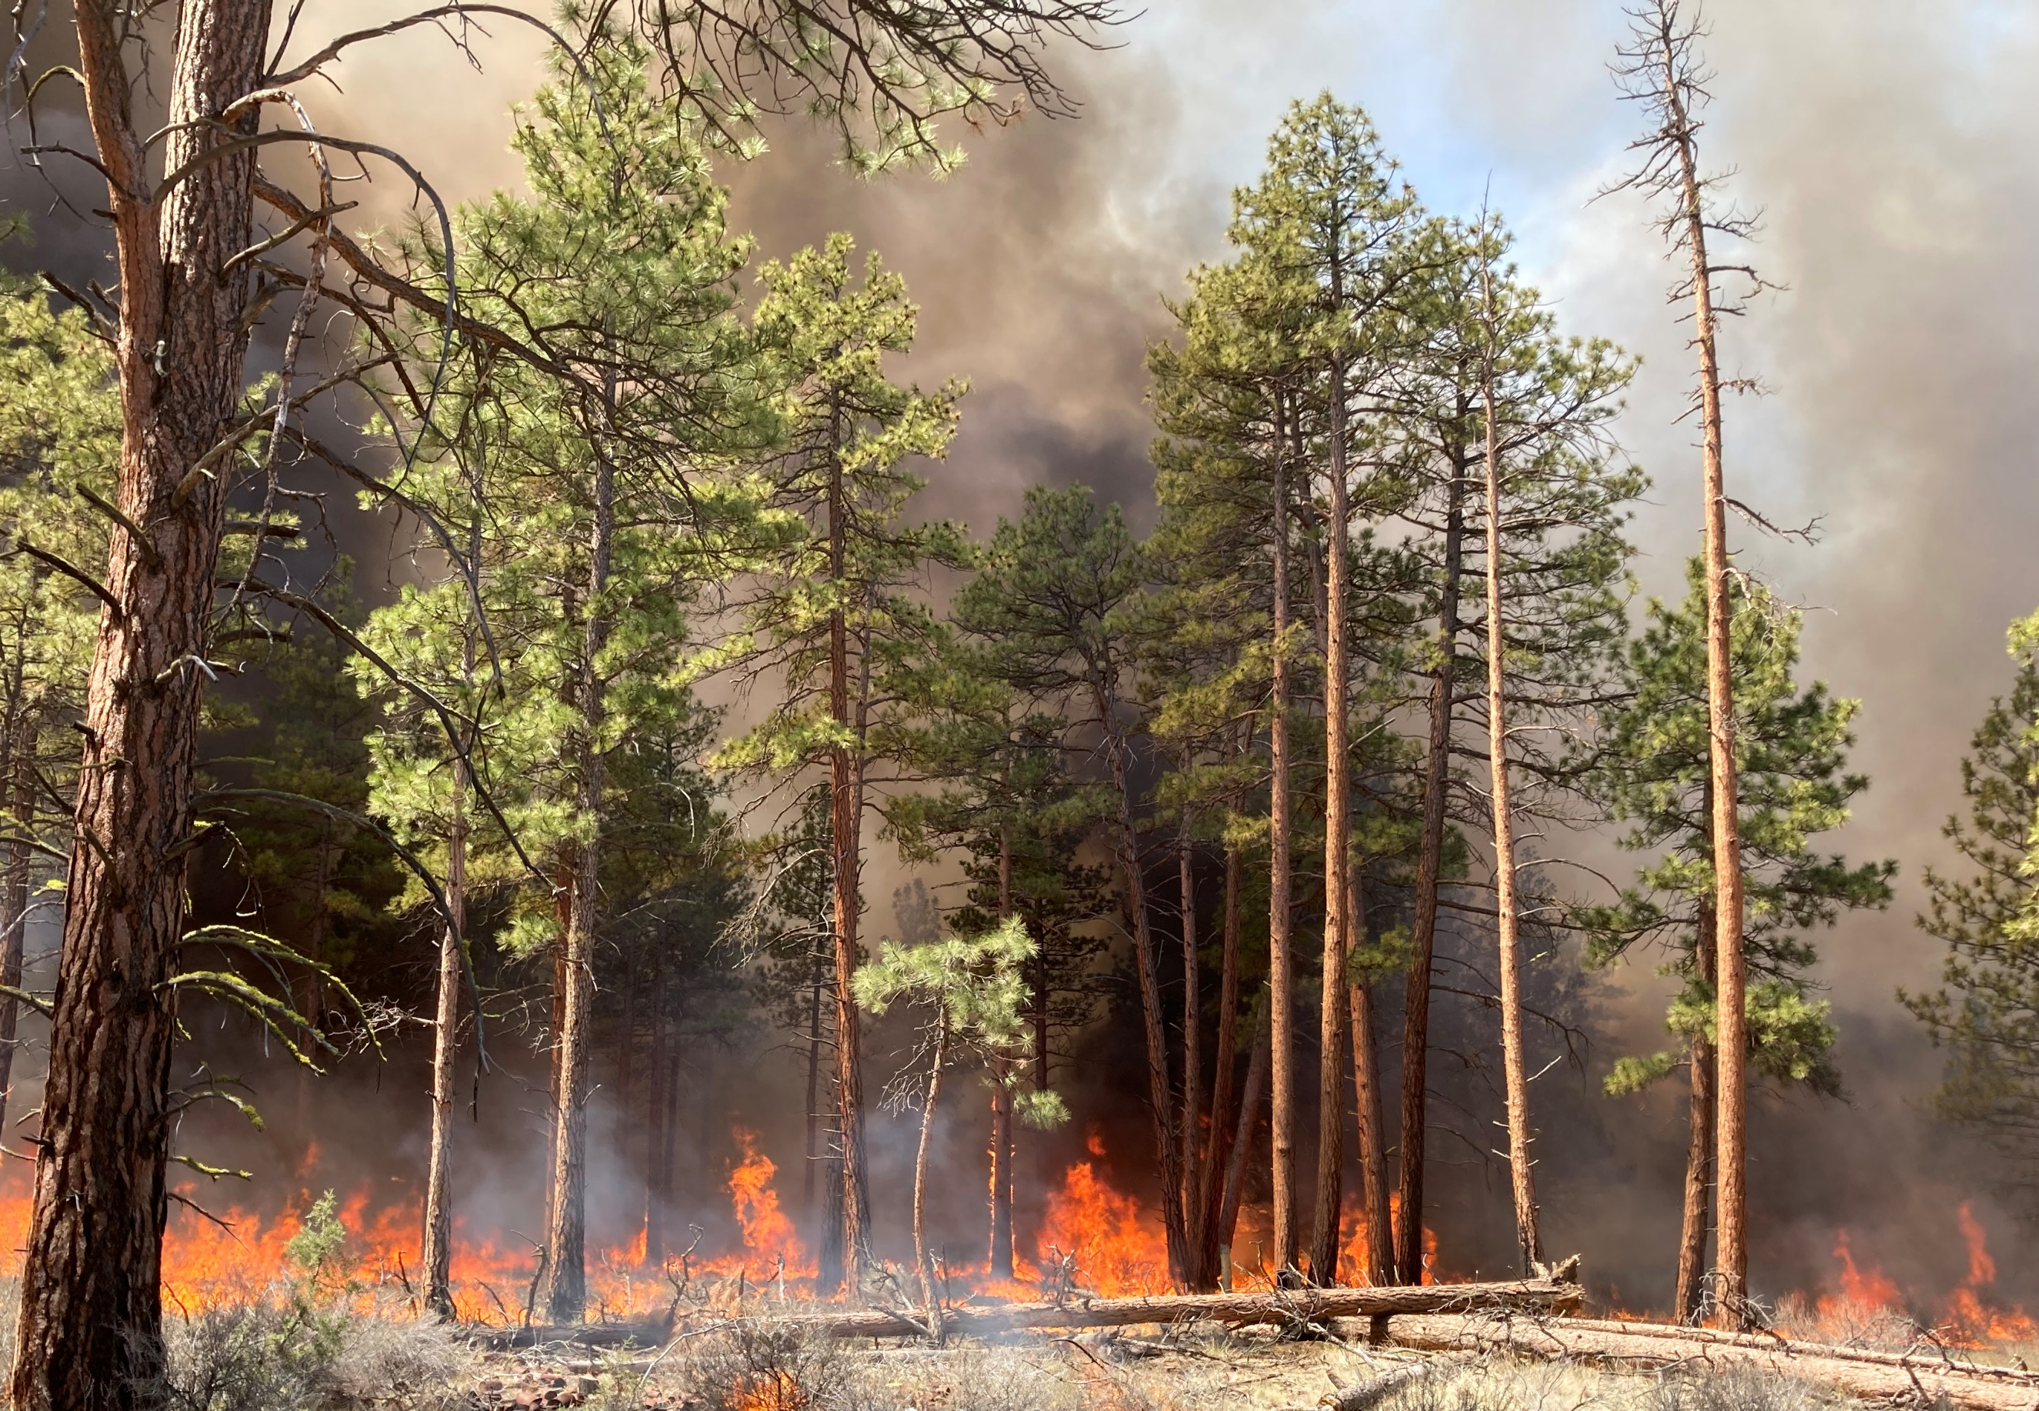
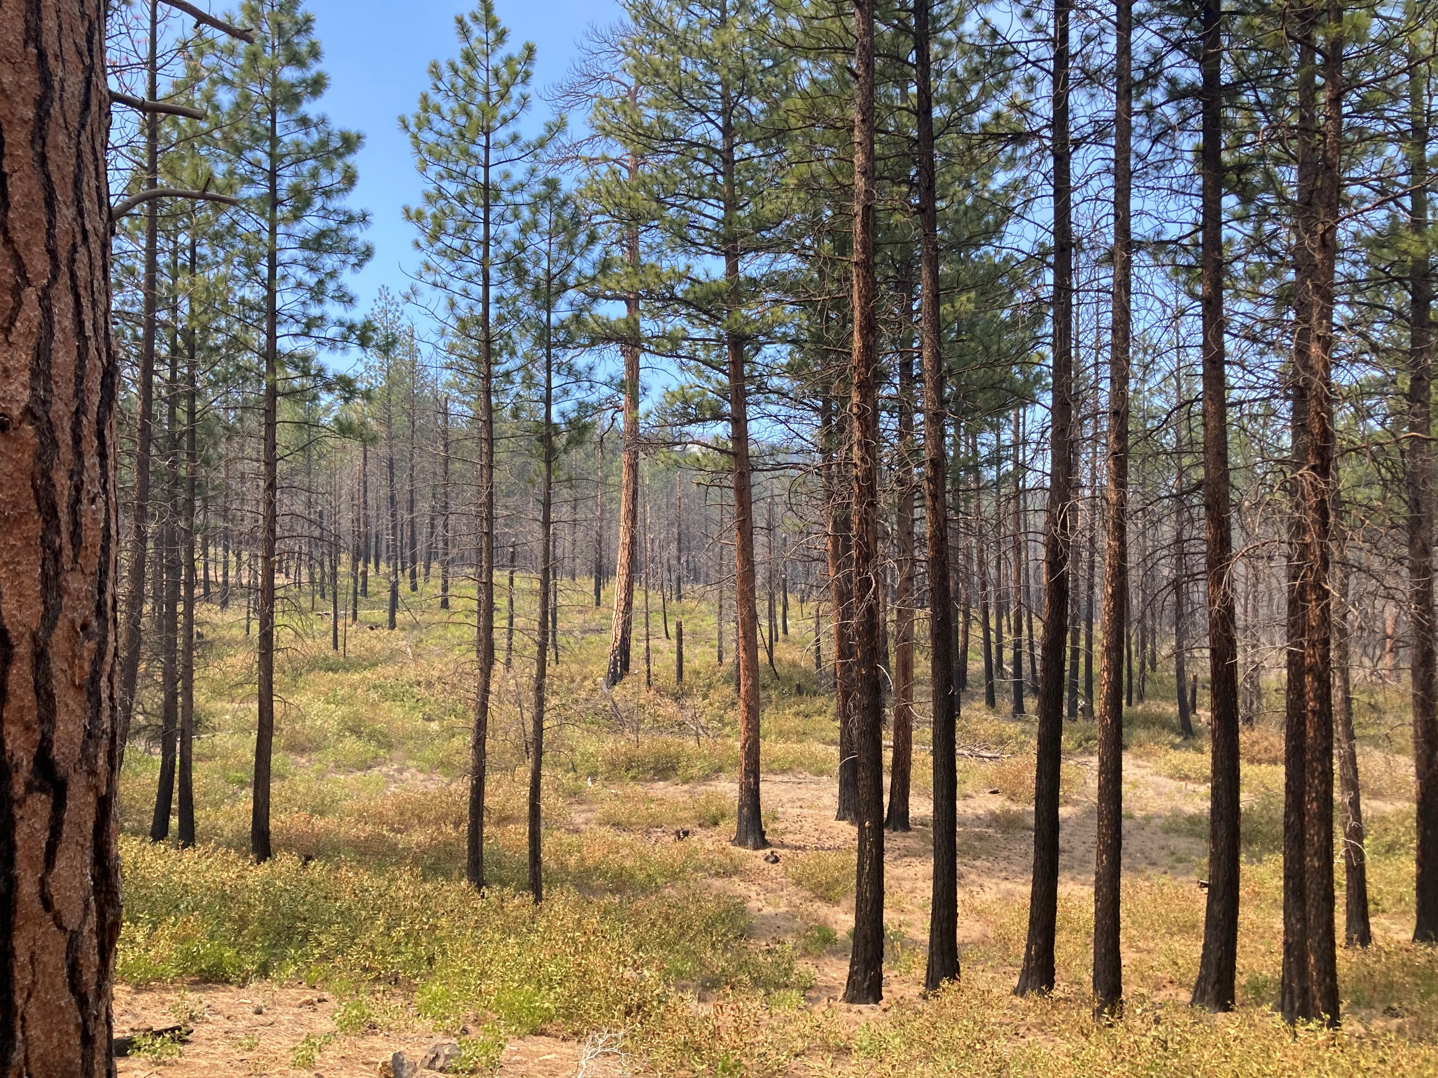
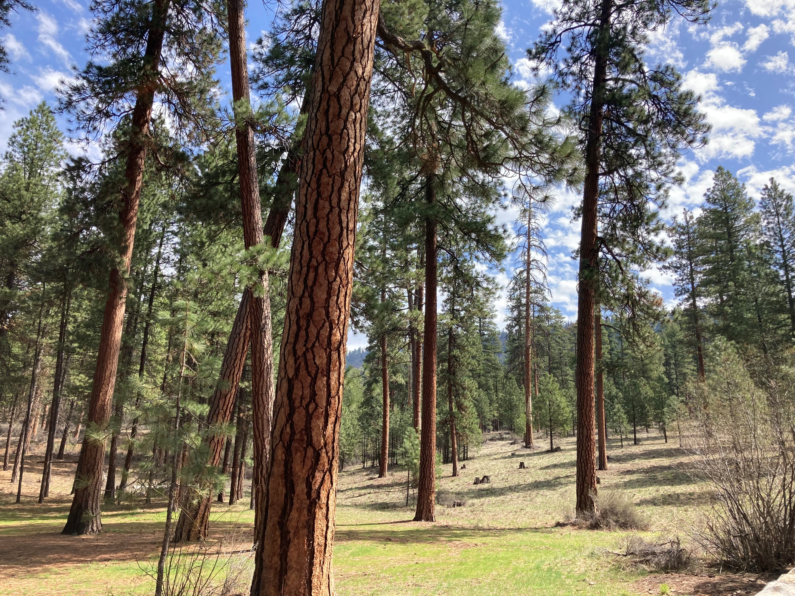
Conclusions

Slide 16
Limitations
Results are first approximation

